Slide 1


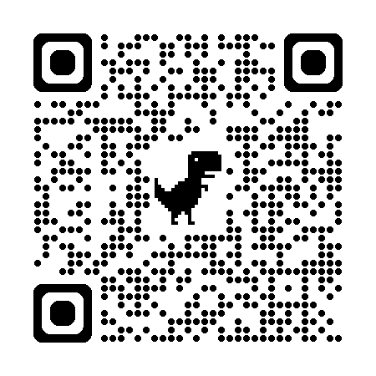
Born in Song
Could you write a spiritual or reflective
poem or a Christian worship song?
Would you like to perform your work or watch it
performed live at our concert in Horsham?
For further details, please scan the QR code or visit:
www.cornerstone-mc.org.uk/BornInSong
Closing date for entries: Sunday, 28 June 2026
Cornerstone Methodist Church is a registered charity 1134052

